Slide 1


Biostatistical methods
HEALS CONCEPTS & METHOLOGY WORKSHOP THESSALONIKI 16-20.III.2014
www.heals-eu.eu
E
P
A
R

Slide 2
Predictive models: should they be used more often in environmental epidemiology?
Environment-wide association study (EWAS): gene-environment interaction
Stream 5 / WP 16

Slide 3
What we could generally do in statistics for environmental sciences
Methods
Statistical modelling
Meta-analysis
Multivariate approaches (PCA, MCA, CA, DA, …)
Multilevel / longitudinal analysis
Time to event
Missing data (MI, EM, MICE, WGEE, …)
Propensity matching
Data mining / predictive modelling / machine or statistical learning / pattern recognition
Ensemble (random forests, bagging, boosting, decision trees)
LASSO, elastic net, LARS
SVM, RVM, Bayes net, naïve Bayes, k-NN
Computer intensive: bootstrap, Jackknife, crossvalidation
Time-series
Classical
DLM, GAM + splines
Spatial (ecological studies)
Disease mapping
Spatial (& temporal) modelling
Bayesian (MCMC), BMA
FMM, LCA
Sample size & power, minimal detectable risk
Survey methods
EWAS, GEWIS

Slide 4
Regression or classification problem
We might be interested in predicting (measured) pollution concentration(s) from housing characteristics (questionnaires)
Use the ‘best’ model to investigate the impact of model prediction on health outcome(s)
Regression method will be the main focus today
Another way is classification problem, where we are interested how to classify two or more categories by means of predictors

Slide 5
Comfort parameters
Year of construction
Classroom cleaning habbits
Pollutant (e.g., Formaldehyde) [n = 500]
Asthma attacks (<12 months)
Itchy rash (<6 months)
Wheeze (<12 months)
Allergic rhinitis
n = 5,000
Predictive model

Slide 6
General philosophy behind the scene
Predictive models have been used in engineering, medicine, other disciplines including env. monitoring (e.g., dispersion models to measure traffic pollution)
As we are often limited by the cost,
Developing new predictive models could be useful in situations where cheaper studies based on, say questionnaires, could replace more expensive or less ubiquitous methods of measuring pollutants, assessing bio-pollutants, …

Slide 7
Lasso: Least Absolute Shrinkage and Selection Operator
Relies upon the same principles of a linear model
But uses an alternative fitting procedure to estimate β₀, β₁, β₂, …, β_{k} coefficients
Idea: introduces some innocuous ‘bias’ and reduce model variance → reduces model Mean Squared Error (MSE) by a bigger margin in this trade-off
Sets some of the coefficients to 0 ← ↑ restriction
Final model, the response will be related to a smaller subset of variables (viz, those with non-zero βs)

Slide 8
GAM: Generalised Additive Model
More flexible than OLS regression
Each predictor is linearly added in the equation
But, the relationship between outcome and each predictor is modelled by a curve f_{k}
Allowing non-linear ‘smooth’ relationships between outcome and predictors

Slide 9
Ensemble methods and SVM
The tree-based regression methods (bagging, random forests, boosting, decision trees) are more difficult to interpret
But, are more flexible in terms of predicting the outcome
Support Vector Machines (SVM) are perhaps the most flexible as well as robust
But, are not interpretable generally (cf. next slide)

Slide 10
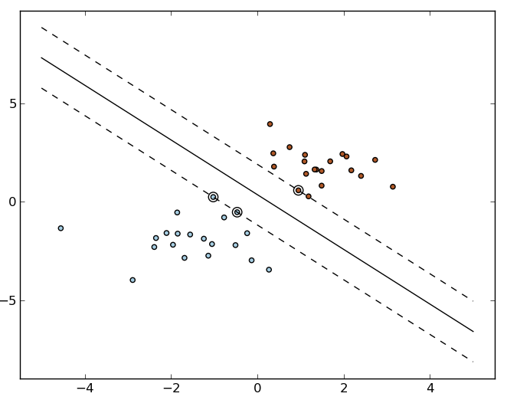
SVM: example

Slide 11
Challenges (1): overfitting
On many occasions, simple models like logistic or linear regression fit better than sophisticated techniques like ensemble methods or SVM
It is counterintuitive that more flexible models does not necessarily guarantee a better prediction
This has often to do with the ‘overfitting’ problem with more flexible models, where the ‘noise’ in the data fits ‘very well’ in the training data, but yields a poor prediction in the test (or validation) data

Slide 12

Challenges (2): no free lunch
Which method is the best? Which model is the best?
Data → training and test datasets (or k-fold CV)
Error of the model is often measured by a quantity called Mean Squared Error (MSE)
Cross-validation (CV): method of estimating test MSE using training data

Slide 13


Challenges (3): bias-variance trade-off
For a given value x₀ in the test data:
= Expected test MSE
We need low estimator variance and bias [= first two terms]
Variance refers to the amount by which f would change if we estimated it using a different training data set
Notes:
Expected test MSE refers to the average test MSE that we would obtain if we repeatedly estimated f using a large number of training data, and tested at given x₀. Since the training data are used to fit the statistical learning method, different training data will result in a different f. But ideally the estimate for f should not vary too much between training sets. However, if a method has high variance then small changes in the training data can result in large changes in f. In general, more flexible statistical methods have higher variance. Bias refers to the error that is introduced by approximating a real-life problem. Generally, more flexible methods result in less bias. As a general rule, as we use more flexible methods, the variance will increase and the bias will decrease. As we increase the flexibility, the bias tends to initially
decrease a lot faster than the increase in variance. Consequently, the expected test MSE declines until a point. However, at some point increasing flexibility has little impact on bias, but it starts to significantly increase the variance. When this happens, the test MSE starts increasing once again.

Slide 14
Supervised vs. unsupervised learning
Supervised learning:
Linear, LARS, LASSO (or logistic) regression, LDA/QDA
GAM
Boosting, bagging, random forests, decision trees (ensemble)
SVM (linear / non-linear)
k-nearest neighbours
Neural Networks, (sparse) PLS, Kohonen’s SOM, naïve Bayes classifier, wavelets, ...
Unsupervised learning:
(when we do not have a response variable to model)
Cluster analysis (AHC, k-means) (cf. next slide)
PCA, FA
Latent Class Analysis (LCA), Latent Trait Analysis (LTA), Finite Mixture Models (FMM), ...

Slide 15
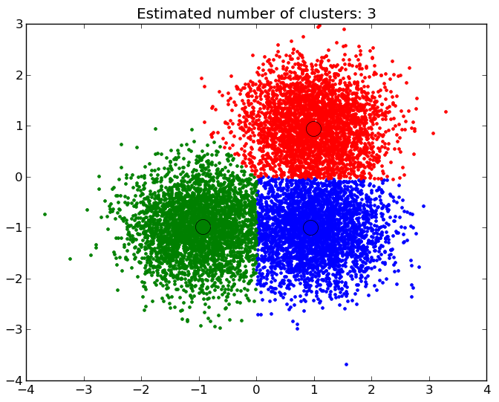
Cluster analysis: example
Exposome 1:
Risk for diseases a, b, c
Exposome 2:
Risk for diseases p, q, r
Exposome 3:
Risk for diseases x, y, z

Slide 16
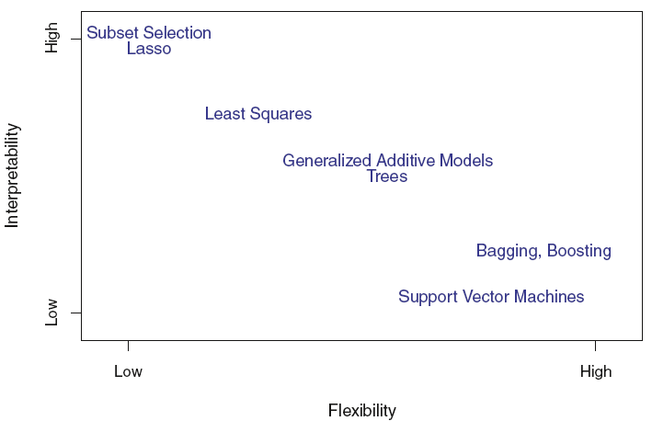
Predictive models: flexibility vs. interpretability

Slide 17
Data mining: pros and cons (1)
The methods list is not exhaustive, and
The estimation is computer-intensive, and
Search for the optimum method is challenging and time consuming for each outcome
Software – Python, R, Stata®
Commercial software – SAS Enterprise miner®, SPSS Clementine®, Matlab® tools, … provide packages, but at a certain cost

Slide 18
Data mining: pros and cons (2)
Even if γ = 0, we might still find spurious association between the predicted pollutant and outcome, because of the direct relationship β between the building characteristics and outcome if β = f(α) or α = g(β)
Pollutant
α
Building characteristics
γ = 0
β
Outcome

Slide 19
Environment-Wide Association Study (1)
Concept: Genome-Wide Association Study (GWAS) format → EWAS (Patel et al., 2012 on NHANES study applied to pesticides’ impact on Type 2 diabetes)
Uses all environmental factors evaluated (‘top-down’ and ‘agnostic’ approach):
A data-driven procedure to create hypothesis
Statistical significance correction for multiple comparisons
Pros: ↓ no. of false +ve findings due to selective reporting (= ‘cherry picking’) of significant results
Cons: cross-sectional study

Slide 20
Environment-Wide Association Study (2)
Lind et al., 2013 reported a cross-sectional EWAS study for Metabolic Syndrome (MetS) and 76 environmental factors (cf. next 2 slides)
Thomas, 2010 discussed different methodology to implement gene-enviroment interaction for GxG & GxE interaction applied to interaction between smoking / well-done red meat and CYP1A2 / NAT2 genes in producing the carcinogenic aryl- / heterocyclic amines involved in the causal pathway for bladder / colon cancer
Patel et al, 2013: GxE study on Type 2 diabetes (cf. later)

Slide 21
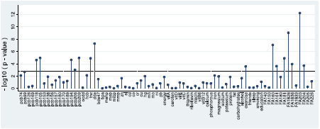
‘Manhattan’ plot
“Manhattan” plot with p-values (expressed at −log₁₀ scale) for 76 environmental contaminants or lifestyle factors vs. metabolic syndrome (MetS) in an “Environmental and Lifestyle-Wide Association Study” (ELWAS). The broken line denotes variables with adjusted (for multiple comparisons) false discovery rate (FDR) <5% (Lind et al., 2013)
[“FDR” in GWAS parlance means ‘statistical significance’]
Notes:
ELWAS study helped to preselect significant variables, which were later used in a multiple logistic regression model to test the additive effects of each of these significant variables when entered jointly in the model.
Remark: -log₁₀ 0.05 = 1.30.

Slide 22
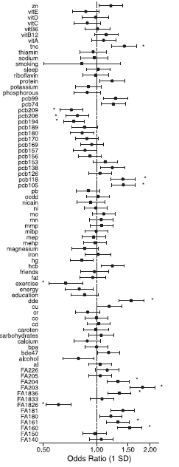
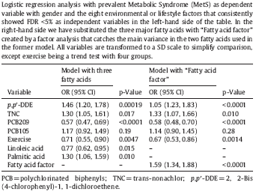
Forest plot & “final” model
Forest plot showing the OR (95%CI) for the associations between 76 environmental contaminants or lifestyle factors vs. syndrome (MetS). A star before or after the CI denotes variables with a FDR) <5% (Lind et al., 2013)
Notes:
Remark: 8 out of 14 significant association were chosen for the final model owing to multicollinearity between those predictors.

Slide 23
Gene-Environment-Wide Interaction Study
The proportion of heritability for most complex diseases (e.g., asthma) that have been studied remains small (Thomas, 2010)
In GWAS studies, the vast majority of the associations discovered with common variants only have modest effect sizes; RR generally varying from 1.2-1.5
Some “dark matter” could be due to GxE effect or complex pathways involving multiple genes
A possibly way to unravel a part of this vast “dark matter” of causality could be through use of new -omics* technologies or by use of GxE studies [GEWIS]
Notes:
* proteomics, metabolomics, transcriptomics, microbial genomics, ... or new gene-sequencing.
In astrophysics, universe’s dark matter = 23%, dark energy = 73%, known matter = 4%.

Slide 24
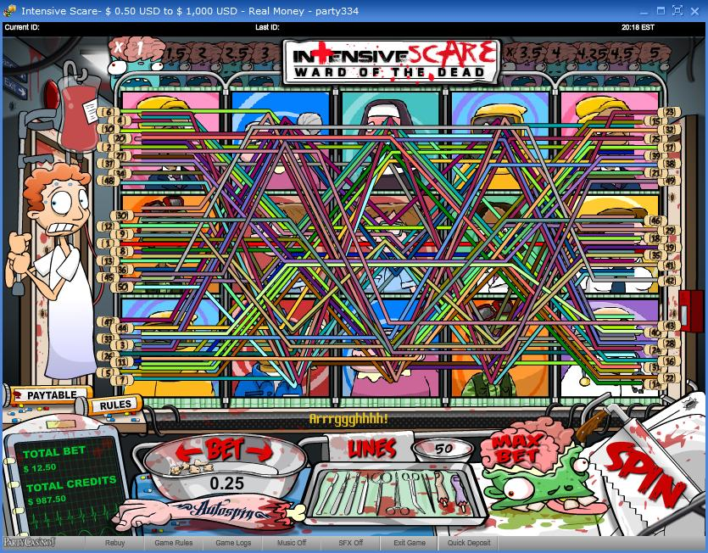
SNPs: a ‘casino’ problem
Try jackpot: “max Bet per line” x “all lines”
= all SNPs x very large population,
BUT this is not optimal, so we have to choose between:
All SNPs x a few subjects, or
A few SNPs x large population
I would opt for the 2nd option with large sample size & a few ‘targeted’ SNPs:
Why ? Because I think that:
- If we are dealing with SNPs [and not GWAS, where one uses the entire gene spectrum (= ‘gene-chip’) of an individual in an ‘agnostic’ way] → many SNPs are ‘innocuous’ = not associated with disease
But on targeting the “SNPs of interest” [lit. review]: if we win, we are more likely to win it BIG (= find a significant association)

Slide 25
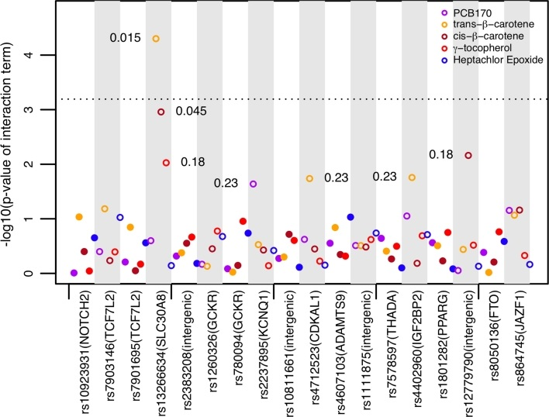
Εὕρηκα: ‘Targeted’ SNP x 5 exposures*
Bonferroni corrected p-value
Notes:
* Serum-based environmental factors.

